Slide 1
ABAP Training Course New feature in HANA for ABAP Development
<Alan Li> | Application Developer
Taipei | Monday, October 14, 2024

Slide 2

Agenda
1
Extended expressions
2
New ABAP Conversions
3
New ABAP SQL
4
Native SQL
5
ADBC

Slide 3
Concatenating Literals and Variables
Extended expressions
CONCATENATE was used to concatenate strings, literals and variables. In this methodology, hardcoded strings were kept in single quotes.
CONSTANTS : lc_matnr TYPE mara-matnr VALUE 'FG326'.
DATA: lv_output TYPE string. CONCATENATE 'The material no' lc_matnr INTO lv_output SEPARATED BY space.
WRITE: lv_output.
ECC
Pipe symbol(|) is used along with & is used to concatenate. With this new way, hardcoded strings are to be kept inside || and Constants as well as Variables are kept inside |{ }|. Values to be concatenated are separated by '&'.
CONSTANTS : lc_matnr TYPE mara-matnr VALUE 'FG326'. WRITE : |The material no | & | { lc_matnr } |.
ABAP 7.40~

Slide 4
Repeating Values
Extended expressions
REPEAT which can be used to repeating output. This can be effectively used in some of the scenario and reduce LOOPs and lines of code.
* Extended Expressions : Repeating Values - Variant 1 WRITE : / |{ repeat( val = 'MAT' occ = 3 ) }|. MATMATMAT “ Extended Expressions : Repeating Values - Variant 2 WRITE : / |1| & |{ repeat( val = '_' occ = 8 ) }| & |10|. 1________10
“ Extended Expressions : Repeating Values - Error Handling TRY . WRITE : / |{ repeat( val = 'A' occ = -1 ) }|. CATCH cx_sy_strg_par_val. WRITE : / 'Error!'. Error! ENDTRY.
ABAP 7.40~

Slide 5
Repeating Values
Extended expressions
REPEAT which can be used to repeating output. This can be effectively used in some of the scenario and reduce LOOPs and lines of code.
* Extended Expressions : Repeating Values - Variant 1 DATA: lv_output TYPE string.
DATA: lv_counter TYPE i.
DO 3 TIMES.
lv_output = lv_output && ‘MAT‘.
ENDDO.
WRITE: / lv_output. MATMATMAT
ECC

Slide 6
Repeating Values
Extended expressions
REPEAT which can be used to repeating output. This can be effectively used in some of the scenario and reduce LOOPs and lines of code.
" Extended Expressions : Repeating Values - Variant 2 DATA: lv_output TYPE string.
DATA: lv_counter TYPE i.
lv_output = '1'.
DO 8 TIMES.
lv_output = lv_output && '_'.
ENDDO.
lv_output = lv_output && '10'.
WRITE: / lv_output. 1________10
ECC

Slide 7
Repeating Values
Extended expressions
REPEAT which can be used to repeating output. This can be effectively used in some of the scenario and reduce LOOPs and lines of code.
" Extended Expressions : Repeating Values - Error Handling DATA: lv_output TYPE string.
DATA: lv_counter TYPE i.
DATA: lv_occ TYPE i VALUE -1. " Simulate wrong repeat times
IF lv_occ < 0.
WRITE: / 'Error!’. Error!
ELSE.
DO lv_occ TIMES.
lv_output = lv_output && 'A'.
ENDDO.
WRITE: / lv_output.
ENDIF.
ECC

Slide 8
Logical Expressions
Extended expressions
Logical Expressions make it possible that expressions can be written inside IF or similar constructs. It reduces lines of code to be written.
" Extended Expressions : Computation in logical Expressions DATA : lv_qty TYPE kwmeng VALUE 10, lv_uprice TYPE kbetr VALUE 20. *" Simple Expression IF lv_qty * lv_uprice < 220. WRITE : / |The total amount is less than| & | 220 |. ENDIF. *" Brackets can be used to combine expressions IF ( lv_qty * lv_uprice ) + 20 EQ 220. WRITE : / |Complex expressions are also possible!|.
ENDIF.
ABAP 7.40~

Slide 9
Logical Expressions
Extended expressions
Logical Expressions make it possible that expressions can be written inside IF or similar constructs. It reduces lines of code to be written.
" Extended Expressions : Computation in logical Expressions DATA : lv_qty TYPE kwmeng VALUE 10,
lv_uprice TYPE kbetr VALUE 20,
lv_total TYPE p.
lv_total = lv_qty * lv_uprice. IF lv_total < 220. WRITE: / 'The total amount is less than 220'.
ENDIF.
lv_total = ( lv_qty * lv_uprice ) + 20. IF lv_total = 220. WRITE: / 'Complex expressions are also possible!'.
ENDIF.
ECC

Slide 10
Inline Variable Declaration
Extended expressions
Inline Declaration make it possible to define variables and work areas on the fly. There is no need to write a separate line for variable declaration. This construct also help to reduce lines of code.
" Extended Expressions : Inline Declarations - Variables SELECT matnr FROM mara INTO TABLE @DATA(lt_matnr). IF sy-subrc IS INITIAL. READ TABLE lt_matnr INTO DATA(lwa_matnr) INDEX 1. IF sy-subrc IS INITIAL. WRITE : |Material successfully read! | & | { lwa_matnr-matnr }| & |Inline declaration works!|. ENDIF. SKIP. LOOP AT lt_matnr INTO DATA(lwa_matnr_others). WRITE : / |{ sy-tabix }| & |Material no:| & |{ lwa_matnr_others-matnr }|. IF sy-tabix > 20. EXIT. ENDIF. ENDLOOP. ENDIF.
ABAP 7.40~

Slide 11
Inline Variable Declaration
Extended expressions
Inline Declaration make it possible to define variables and work areas on the fly. There is no need to write a separate line for variable declaration. This construct also help to reduce lines of code.
" Extended Expressions : Inline Declarations - Variables DATA: lt_matnr TYPE TABLE OF mara,
lwa_matnr TYPE mara,
lwa_matnr_others TYPE mara.
SELECT matnr FROM mara INTO TABLE lt_matnr.
IF sy-subrc IS INITIAL.
READ TABLE lt_matnr INTO lwa_matnr INDEX 1.
IF sy-subrc IS INITIAL.
WRITE: / 'Material successfully read!' && lwa_matnr-matnr && 'Inline declaration works!'.
ENDIF.
LOOP AT lt_matnr INTO lwa_matnr_others.
WRITE: / sy-tabix && 'Material no:' && lwa_matnr_others-matnr.
IF sy-tabix > 20.
EXIT.
ENDIF.
ENDLOOP.
ENDIF.
ECC

Slide 12
Inline field-symbol declaration - 1
Extended expressions
Inline Declaration make it possible to define field-symbols on the fly. There is no need to write a separate line for field-symbol declaration. This construct also helps to reduce lines of code.
* Extended Expressions : Inline Declarations – Field Symbols " Variant 1 as a READ work area
SELECT matnr FROM mara INTO TABLE @DATA(lt_mara).
IF sy-subrc IS INITIAL. READ TABLE lt_mara ASSIGNING FIELD-SYMBOL(<lfs_mara>) INDEX 1. IF sy-subrc IS INITIAL. WRITE : |Material = { <lfs_mara>-matnr } |. ENDIF. ENDIF.
* Extended Expressions : Explicit Declarations – Field Symbols " Variant 1 as a READ work area
DATA: lt_mara TYPE TABLE OF mara.
FIELD-SYMBOLS: <lfs_mara> TYPE mara.
SELECT matnr FROM mara INTO TABLE lt_mara.
IF sy-subrc IS INITIAL.
READ TABLE lt_mara ASSIGNING <lfs_mara> INDEX 1.
IF sy-subrc IS INITIAL.
WRITE: |Material = { <lfs_mara>-matnr }|.
ENDIF.
ENDIF.
ABAP 7.40~
ECC

Slide 13
Inline field-symbol declaration – 2
Extended expressions
" Variant 2 as a LOOP work area
SELECT matnr FROM mara INTO TABLE @DATA(lt_mara).
IF sy-subrc IS INITIAL.
LOOP AT lt_mara ASSIGNING FIELD-SYMBOL(<lfs_mara_another>). WRITE : / |Material no: { <lfs_mara_another>-matnr } |. IF sy-tabix > 10. EXIT. ENDIF. ENDLOOP.
ENDIF.
" Variant 2 as a LOOP work area
DATA: lt_mara TYPE TABLE OF mara.
FIELD-SYMBOLS: <lfs_mara_another> TYPE mara.
SELECT matnr FROM mara INTO TABLE lt_mara.
IF sy-subrc IS INITIAL.
LOOP AT lt_mara ASSIGNING <lfs_mara_another>. WRITE : / |Material no: { <lfs_mara_another>-matnr } |. IF sy-tabix > 10. EXIT. ENDIF. ENDLOOP.
ENDIF.
ABAP 7.40~
ECC

Slide 14
Inline declaration in SQL - 1 Inline Declaration make it possible to define internal table , Work area and Variable on the fly from within the query. There is no need to write a separate line for internal table , Work area, and Variable declaration
Extended expressions

Slide 15
Inline declaration in SQL - 2
Extended expressions
" Extended Expressions : Inline Declarations - SQL *DATA : lt_mara TYPE STANDARD TABLE OF mara. " Creating an internal table inline
SELECT matnr, ersda FROM mara INTO TABLE @DATA(lt_mara). " Escaping host variable with @
IF sy-subrc IS INITIAL. READ TABLE lt_mara INTO DATA(lwa_mara) INDEX 1. IF sy-subrc IS INITIAL. WRITE : |Material successfully READ! | & |Inline declaration works!|. ENDIF. ENDIF.
" Creating a Variable inline SELECT SINGLE matnr FROM mara INTO @DATA(lv_matnr).
" Creating a work area inline SELECT SINGLE matnr, ersda FROM mara INTO @DATA(lwa_work_area).
ABAP 7.40~

Slide 16
VALUE Expressions - 1
Extended expressions
This provides a powerful mechanism to declare as well as initialize internal table s. Syntax also facilitates to set a type of internal table .
VALUE expression has two types:
Non-generic data type e.g. type can be defined before using it with VALUE keyword. The Type created using this mechanism is Structured or Table type.
2. Using # character for type where operand position is fixed and identifiable

Slide 17
VALUE Expressions - 2
Extended expressions
“ Extended Expressions : Value Expression TYPES : BEGIN OF lty_value, field1 TYPE i, field2 TYPE i, END OF lty_value, ltty_value TYPE STANDARD TABLE OF lty_value WITH EMPTY KEY. DATA( lt_values ) = VALUE ltty_value( ( field1 = 1 field2 = 2 ) ( field1 = 4 field2 = 3 ) ). LOOP AT lt_values ASSIGNING FIELD-SYMBOL(<lfs_value>). WRITE : / <lfs_value>-field1, space , <lfs_value>-field2. ENDLOOP.
ABAP 7.40~
1 2
4 3

Slide 18
VALUE Expressions - 2
Extended expressions
WRITE: / 'Variant 1'.
TYPES: BEGIN OF lty_value,
field1 TYPE i,
field2 TYPE i,
END OF lty_value,
ltty_value TYPE STANDARD TABLE OF lty_value WITH EMPTY KEY.
DATA: lt_values TYPE ltty_value,
ls_value TYPE lty_value.
FIELD-SYMBOLS: <lfs_value> TYPE lty_value.
ls_value-field1 = 1.
ls_value-field2 = 2.
APPEND ls_value TO lt_values.
ls_value-field1 = 4.
ls_value-field2 = 3.
APPEND ls_value TO lt_values.
LOOP AT lt_values ASSIGNING <lfs_value>.
WRITE: / <lfs_value>-field1, space, <lfs_value>-field2.
ENDLOOP.
ECC

Slide 19
VALUE Expressions - 3
Extended expressions
" Extended Expressions : Value Expression lt_values = VALUE ltty_value( ( field1 = 1 ) ( field2 = 2 ) ( field1 = 4 ) ( field2 = 3 ) ). LOOP AT lt_values ASSIGNING <lfs_value>. WRITE : / <lfs_value>-field1, space , <lfs_value>-field2. ENDLOOP.
ABAP 7.40~
VALUE ltty_value(
)
( field1 = 1 )
( field2 = 2 )
( field1 = 4 )
( field2 = 3 )
field1 field2
1 2
4 3
field1 field2
1 0
0 2
4 0
0 3

Slide 20
VALUE Expressions - 3
Extended expressions
WRITE: / 'Variant 2'.
* Initialize values
CLEAR lt_values.
ls_value-field1 = 1.
APPEND ls_value TO lt_values.
ls_value-field2 = 2.
APPEND ls_value TO lt_values.
ls_value-field1 = 4.
APPEND ls_value TO lt_values.
ls_value-field2 = 3.
APPEND ls_value TO lt_values.
* Loop write exporting values
LOOP AT lt_values ASSIGNING <lfs_value>.
WRITE: / <lfs_value>-field1, space, <lfs_value>-field2.
ENDLOOP.
ECC

Slide 21
VALUE Expressions - 4
Extended expressions
" Extended Expressions : Value chaining
DATA : lt_range TYPE RANGE OF i. lt_range = VALUE #( sign = 'I' option = 'EQ' ( low = 1 ) ( low = 2 ) ). WRITE : |Sign | & |Option | & |Low | & | High|. WRITE : / |----------------------------------------------|. LOOP AT lt_range ASSIGNING FIELD-SYMBOL(<lfs_range>). WRITE : / <lfs_range>-sign, <lfs_range>-option, <lfs_range>-low, <lfs_range>-high. ENDLOOP.
ABAP 7.40~
Sign Option Low High
------------------------------
I EQ 1 0
I EQ 2 0

Slide 22
VALUE Expressions - 4
Extended expressions
WRITE: / 'Variant 3'.
DATA: lt_range TYPE RANGE OF i,
ls_range TYPE LINE OF lt_range.
* Fill range table
ls_range-sign = 'I'.
ls_range-option = 'EQ'.
ls_range-low = 1.
APPEND ls_range TO lt_range.
ls_range-low = 2.
APPEND ls_range TO lt_range.
WRITE: 'Sign', space, 'Option', space, 'Low', space, 'High'.
WRITE: / '----------------------------------------------'.
LOOP AT lt_range ASSIGNING FIELD-SYMBOL(<lfs_range>).
WRITE: / <lfs_range>-sign, <lfs_range>-option, <lfs_range>-low, <lfs_range>-high.
ENDLOOP.
ECC

Slide 23
VALUE Expressions - 5
Extended expressions
" Extended Expressions : Value chaining WRITE : / | Variant 4|.
DATA : lt_range TYPE RANGE OF i. lt_range = VALUE #( sign = 'I' option = 'EQ' ( low = 1 ) ( low = 2 ) sign = 'I' option = 'BT' ( low = 5 high = 10 ) ). WRITE : |SIGN | & |Option | & |Low | & | High|. WRITE : / |----------------------------------------------|. LOOP AT lt_range ASSIGNING <lfs_range>. WRITE : / <lfs_range>-sign, <lfs_range>-option, <lfs_range>-low, <lfs_range>-high. ENDLOOP.
ABAP 7.40~
Sign Option Low High
-----------------------------
I EQ 1 0
I EQ 2 0
I BT 5 10

Slide 24
VALUE Expressions - 5
Extended expressions
WRITE: / 'Variant 4'.
CLEAR lt_range.
* Fill 2nd range table
ls_range-sign = 'I'.
ls_range-option = 'EQ'.
ls_range-low = 1.
APPEND ls_range TO lt_range.
ls_range-low = 2.
APPEND ls_range TO lt_range.
ls_range-option = 'BT'.
ls_range-low = 5.
ls_range-high = 10.
APPEND ls_range TO lt_range.
WRITE: 'Sign', space, 'Option', space, 'Low', space, 'High'.
WRITE: / '----------------------------------------------'.
LOOP AT lt_range ASSIGNING FIELD-SYMBOL(<lfs_range>).
WRITE: / <lfs_range>-sign, <lfs_range>-option, <lfs_range>-low, <lfs_range>-high.
ENDLOOP.
ECC

Slide 25
VALUE Expressions - 6
Extended expressions
" Extended Expressions : VALUE-DEFAULT pair DATA : lt_values TYPE STANDARD TABLE OF lty_value WITH EMPTY KEY.
DATA : lv_value TYPE i.
lt_values = VALUE ltty_value( ( field1 = 1 field2 = 5 ) ( field1 = 1 ) ( field1 = 2 field2 = 7 ) ). DO 5 TIMES. lv_value = VALUE #( lt_values[ sy-index ]-field2 DEFAULT -1 ). WRITE : / lv_value. ENDDO.
ABAP 7.40~
5
0
7
1-
1-

Slide 26
VALUE Expressions - 6
Extended expressions
DATA: lt_values TYPE STANDARD TABLE OF lty_value,
ls_value TYPE lty_value,
lv_value TYPE i.
ls_value-field1 = 1.
ls_value-field2 = 5.
APPEND ls_value TO lt_values.
CLEAR ls_value.
ls_value-field1 = 1.
APPEND ls_value TO lt_values.
CLEAR ls_value.
ls_value-field1 = 2.
ls_value-field2 = 7.
APPEND ls_value TO lt_values.
DO 5 TIMES.
CLEAR lv_value.
READ TABLE lt_values INTO ls_value INDEX sy-index.
IF sy-subrc = 0.
IF ls_value-field2 IS INITIAL.
lv_value = -1. “ if field2 is empty，default value is -1
ELSE.
lv_value = ls_value-field2.
ENDIF.
ELSE.
lv_value = -1. " default value -1
ENDIF.
WRITE: / lv_value.
ENDDO.
ECC
ECC

Slide 27
CONV – Conversion Operator - 1 CONV operator converts the argument to specified data type. The parentheses of CONV operator has just like VALUE operator, CONV operator also assumes two variants: 1. Non-generic data types e.g. Custom types defined just before its usage 2. Generic types and these are referred with the help of # character. Attributes and position of generic data type should always be fixed.
Extended expressions

Slide 28
CONV – Conversion Operator - 2
Extended expressions
*Extended Expressions : Conversion Operator DATA : lv_integer TYPE i. lv_integer = SQRT( 5 ) + SQRT( 6 ). WRITE : / lv_integer. " 5 lv_integer = CONV I( SQRT( 5 ) ) + CONV I( SQRT( 6 ) ). WRITE : / lv_integer. " 4
lv_integer = CONV #( SQRT( 25 ) ).
WRITE : / lv_integer. " 5
ABAP 7.40~
DATA: lv_integer TYPE i,
lv_float TYPE f.
lv_float = SQRT( 5 ) + SQRT( 6 ).
lv_integer = TRUNC( lv_float ). " use TRUNC function to get rid of decimal part
WRITE: / lv_integer. " 4
ECC

Slide 29
LET Expression - 1 LET expression defines as well as initialize variables and field-symbols. This works as a local helper for the expression. Some important points to be noticed regarding LET expression are as follows: 1. Variables or Field-symbols defined for LET expressions can't be used outside scope of expression 2. Variables or Field-symbols defined for LET expressions can't be redefined even if they are not accessible outside LET scope 3. LET expression can be encapsulated inside constructors, VALUE operator, FOR operator, COND operator, SWITCH operator etc.
Extended expressions

Slide 30
LET Expression - 2
Extended expressions
" Extended Expressions : LET expression TYPES: BEGIN OF ty_data, field1 TYPE i, field2 TYPE i, END OF ty_data.
DATA : lt_data TYPE TABLE OF ty_data. DO 3 TIMES. DATA(lwa_data) = VALUE ty_data( LET x = sy-index y = sy-index + 1 IN field1 = x field2 = y ). APPEND lwa_data TO lt_data. ENDDO.
cl_demo_output=>display( lt_data ).
" can be encapsulated in other operators DATA(result) = COND #(
WHEN sy-index > 1 THEN
LET calc = sy-index * 2 IN calc
ELSE 0 ).
ABAP 7.40~
ABAP 7.40~

Slide 31
COND & SWITCH operator - 1 COND – This is a Conditional Operator just like SWITCH with some differences. When must be specified at least once in this operator. COND Operator can be clubbed with LET Operator. This operator has two variants just like VALUE Operator: 1. Non-generic data type which can be for example declared before its use 2. # character as an operand, however, in this case, operand type should be fully identifiable
Extended expressions

Slide 32
COND & SWITCH operator - 2 SWITCH – This is a Conditional Operator just like COND with some differences. When must be specified at least once in this operator. SWITCH Operator can be clubbed with LET Operator. This operator has two variants just like VALUE Operator: 1. Non-generic data type which can be for example declared before its use 2. # character as an operand, however, in this case, operand type should be fully identifiable
Extended expressions

Slide 33
COND & SWITCH operator - 3
Extended expressions
*Extended Expressions : COND expression DO 4 TIMES. DATA(value_cond) = COND string( WHEN sy-index = 1 THEN |One| WHEN sy-index = 2 THEN |Two| ELSE |GREATER than 2!| ). WRITE : / value_cond. ENDDO.
ABAP 7.40~

Slide 34
COND & SWITCH operator - 4
Extended expressions
" Extended Expressions : SWITCH expression variation DO 4 TIMES. DATA(value_switch) = SWITCH string(
sy-index WHEN 1 THEN |One| WHEN 2 THEN |Two| ELSE |GREATER than 2!| ). WRITE : / value_switch. ENDDO.
ABAP 7.40~

Slide 35
COND & SWITCH operator - 5
Extended expressions
CLASS cx_cant_be DEFINITION INHERITING FROM cx_no_check. ENDCLASS. cl_demo_output=>display( COND #( LET t = '120000' IN WHEN sy-timlo < t THEN | { sy-timlo TIME = ISO } AM |
WHEN sy-timlo > t AND sy-timlo < '240000' THEN | { CONV t( sy-timlo - 12 * 3600 ) TIME = ISO } PM |
WHEN sy-timlo = t THEN | High Noon |
ELSE THROW cx_cant_be( ) ) ).
ABAP 7.40~

Slide 36
COND & SWITCH operator - 6
Extended expressions
CLASS cx_overflow DEFINITION INHERITING FROM cx_static_check. ENDCLASS.
DATA(out) = cl_demo_output=>new( ).
DO. TRY. out->write( SWITCH string(
sy-index WHEN 1 THEN 'one' WHEN 2 THEN 'two' WHEN 3 THEN 'three' ELSE THROW cx_overflow( ) ) ). CATCH cx_overflow. out->display( ). EXIT. ENDTRY. ENDDO.
ABAP 7.40~

Slide 37
New Operator With new NEW Operator, object declaration is now more intuitive and easy to understand. The older variant continues to be in use. In this new type of declaration, object takes the reference e.g. of a class. This later instantiates the object with the help of the NEW operator.
Extended expressions
" Traditional ABAP DATA: lo_ref TYPE REF TO cl_e2e_static_tbom_gap9.
CREATE OBJECT lo_ref.
ECC
" NEW Operator DATA lo_ref TYPE REF TO cl_e2e_static_tbom_gap9. lo_ref = NEW #( ).
" Or you can make use of inline declaration DATA(lo_ref1) = NEW cl_e2e_static_tbom_gap9( ).
ABAP 7.40~

Slide 38
Alternative to READ TABLE - 1 There is now an alternate for 'READ TABLE' statement which is achieved with help of already existing ASSIGN statement. This is a good to have practice in newer ABAP coding convention if it is used wisely. Some important points to be noticed here: 1. An internal table lookup can be done by using INDEX of the row 1.1 If an invalid index is used to reference data i.e. a row at referred index doesn't exist, in that case, runtime exception CX_SY_ITAB_LINE_NOT_FOUND is thrown. 2. An internal table lookup is possible by searching with a field-value pair. 3. The binary Search option is not available in this variant. All searches are essentially sequential search. 3.1 If internal table data is huge and sorted, it is recommended to use READ TABLE… BINARY SEARCH option to achieve better performance.
Extended expressions

Slide 39
Alternative to READ TABLE - 2
Extended expressions
"Extended Expressions : Alternative to READ TABLE expressions *DATA : lt_mara TYPE STANDARD TABLE OF mara. " Variant 1
SELECT matnr FROM mara INTO TABLE @DATA(lt_mara).
IF sy-subrc IS INITIAL. ASSIGN lt_mara[ 1 ] TO FIELD-SYMBOL(<lfs_mara>). IF sy-subrc IS INITIAL. WRITE : / |Material = { <lfs_mara>-matnr } | . ENDIF. ENDIF.
ABAP 7.40~

Slide 40
Alternative to READ TABLE - 3
Extended expressions
“ Variant 2 ASSIGN lt_mara[ matnr = ‘FG126’ ] TO FIELD-SYMBOL(<lfs_mara1>). ” Variant 3 TRY . WRITE : lt_mara[ 90000 ]-matnr. CATCH cx_sy_itab_line_not_found . WRITE : / | Error in index read! |. ENDTRY.
ABAP 7.40~

Slide 41
FILTER expression - 1 FILTER operator, in simple words, works as a SELECT statement on an internal table. With the help of syntax, it produces an internal table of specified TYPE for the specified condition in WHERE clause. Just like VALUE operator, it assumes two variants: 1. Non-generic data type e.g. type can be defined before using it with FILTER keyword. The Type created using this mechanism is Structured or Table type. 2. Using # character for type where operand position is fixed and identifiable Addition EXCEPT is particularly useful in some of the scenarios where required result is the negation of available condition.
Extended expressions

Slide 42
FILTER expression - 2
Extended expressions
" Extended Expressions : FILTER, works as a SELECT on internal table TYPES : BEGIN OF lty_value, field1 TYPE i, field2 TYPE i, END OF lty_value,
“ Table type should be sorted or hashed TYPES: ltty_value TYPE SORTED TABLE OF lty_value WITH UNIQUE KEY field1 field2. DATA( lt_values ) = VALUE ltty_value( ( field1 = 1 field2 = 2 ) ( field1 = 3 field2 = 4 ) ( field1 = 3 field2 = 5 ) ). DATA : lt_values_filter TYPE ltty_value, lt_values_filtered TYPE ltty_value. WRITE : / |Data : | . LOOP AT lt_values ASSIGNING FIELD-SYMBOL(<lfs_value>). WRITE : / <lfs_value>-field1, space , <lfs_value>-field2. ENDLOOP.
ABAP 7.40~
Data :
1 2
3 4
3 5

Slide 43
FILTER expression - 3
Extended expressions
" Create Filter on Primary Key
lt_values_filter = VALUE ltty_value( ( field1 = 3 field2 = 5 ) ). WRITE : / |Variant 1 : Filter Table, # as operand| . lt_values_filtered = FILTER #( lt_values IN lt_values_filter WHERE field1 = field1 " Primary Key comparison here AND field2 = field2 ). LOOP AT lt_values_filtered ASSIGNING <lfs_value>. WRITE : / <lfs_value>-field1, space , <lfs_value>-field2. ENDLOOP.
ABAP 7.40~
3 5

Slide 44
FILTER expression - 4
Extended expressions
" TYPE can be explicitly mentioned with FILTER Statement WRITE : / |Variant 2 : Filter Table, Table Type ltty_value as Operand | .
REFRESH lt_values_filtered[].
lt_values_filtered = FILTER ltty_value( lt_values IN lt_values_filter WHERE field1 = field1 “ Primary Key comparison here AND field2 = field2 ). LOOP AT lt_values_filtered ASSIGNING <lfs_value>. WRITE : / <lfs_value>-field1, space , <lfs_value>-field2. ENDLOOP.
ABAP 7.40~
3 5

Slide 45
FILTER expression - 5
Extended expressions
" Except keyword can be used to invert the selection with FILTER WRITE : / |Variant 3 : Filter Table, Using 'EXCEPT' Keyword| .
REFRESH lt_values_filtered[].
lt_values_filtered = FILTER #( lt_values EXCEPT IN lt_values_filter WHERE field1 = field1 " Primary Key comparison here AND field2 = field2 ). LOOP AT lt_values_filtered ASSIGNING <lfs_value>. WRITE : / <lfs_value>-field1, space , <lfs_value>-field2. ENDLOOP.
ABAP 7.40~
1 2
3 4

Slide 46
FILTER expression - 6
Extended expressions
" FILTER operator's Basic form can be used without using IN operator. " In all forms of FILTER operator, only AND operator is allowed(no OR). " Syntax in this case is similar to FILTERed form WRITE : / |Variant 4 : Without Filter Table, without IN operator | .
REFRESH lt_values_filtered[].
lt_values_filtered = FILTER #( lt_values " no use of 'IN' WHERE field1 = 3 AND field2 = 5 ). LOOP AT lt_values_filtered ASSIGNING <lfs_value>. WRITE : / <lfs_value>-field1, space , <lfs_value>-field2. ENDLOOP.
ABAP 7.40~
3 5

Slide 47
LINE_EXISTS - 1 LINE_EXISTS is a table function which checks if the specified line exists in the internal table or not. This returns either TRUE or FALSE. Argument of this function can be a simple check or a table expression. Some important points to be noted here: 1. LINE_EXISTS works as a READ TABLE with TRANSPORTING NO FIELDS which returns SY-SUBRC 2. This doesn't return SY-TABIX or SY-INDEX which can indicate the line of match during search
Extended expressions

Slide 48
LINE_EXISTS - 2
Extended expressions
" Extended Expressions : LINE_EXISTS TYPES : BEGIN OF lty_value, field1 TYPE i, field2 TYPE i, END OF lty_value, ltty_value TYPE STANDARD TABLE OF lty_value
WITH EMPTY KEY.
DATA(lt_values) = VALUE ltty_value(
( field1 = 1 field2 = 2 )
( field1 = 3 field2 = 4 ) ). WRITE : |Data : |.
LOOP AT lt_values ASSIGNING FIELD-SYMBOL(<lfs_value>). WRITE : / <lfs_value>-field1, space , <lfs_value>-field2. ENDLOOP.
" Search by Index
IF line_exists( lt_values[ 10 ] ). WRITE : / |Line # 10 exists|. ELSE. WRITE : / |Line # 10 doesn't exist|. ENDIF.
" Variant 2 - Search by field-value pair IF line_exists( lt_values[ field2 = 4 ] ).
WRITE : / |Line for field2 = 4 exists|. ELSE. WRITE : / |Line for field2 = 4 doesn't exist|. ENDIF.
ABAP 7.40~

Slide 49
LINE_EXISTS - 3
Extended expressions
" Extended Expressions : LINE_EXISTS
" Variant 2 - Search by field-value pair
READ TABLE lt_values TRANSPORTING NO FIELDS WITH KEY field2 = 4.
IF sy-subrc = 0.
WRITE: / 'Line for field2 = 4 exists'.
ELSE.
WRITE: / 'Line for field2 = 4 doesn't exist'.
ENDIF.
ECC

Slide 50
LINE_INDEX - 1 The Function LINE_INDEX can be used to search an internal table . This returns the table index where the 1st search result is found. Argument of this function can be a simple check or an expression. Some important points to be noted here: 1. LINE_INDEX works as a READ TABLE with TRANSPORTING NO FIELDS which returns SY-SUBRC 2. This returns SY-TABIX or SY-INDEX which can indicate the line of the match during the search. If no line matches then zero is returned. 3. Function LINE_EXISTS is used just to check existence and doesn't return the index of result found. 4. LINE_INDEX does both the works i.e. it does existence check and returns the index of the result.
Extended expressions

Slide 51
LINE_INDEX - 2
" Extended Expressions : LINE_EXISTS TYPES : BEGIN OF lty_value, field1 TYPE i, field2 TYPE i, END OF lty_value, ltty_value TYPE STANDARD TABLE OF lty_value WITH EMPTY KEY.
DATA(lt_values) = VALUE ltty_value( ( field1 = 1 field2 = 2 ) ( field1 = 3 field2 = 4 ) ).
WRITE : |Data : |.
LOOP AT lt_values ASSIGNING FIELD-SYMBOL(<lfs_value>). WRITE : / <lfs_value>-field1, space , <lfs_value>-field2. ENDLOOP.
IF line_index( lt_values[ 10 ] ) > 0. " Variant 1 - Search by Index WRITE : / |Line # 10 exists|. ELSE. WRITE : / |Line # 10 doesn't exist|. ENDIF. IF line_index( lt_values[ field2 = 4 ] ) > 0. " Variant 2 - Search by field-value pair WRITE : / |Line for field2 = 4 exists|. ELSE. WRITE : / |Line for field2 = 4 doesn't exist|. ENDIF.
Extended expressions
ABAP 7.40~

Slide 52
LINE_INDEX - 2
" Traditional ABAP – Read table with key transporting no fields
DATA: lt_values TYPE TABLE OF lty_value,
lwa_value TYPE lty_value,
lv_index TYPE sy-tabix.
READ TABLE lt_values INTO lwa_value WITH KEY field2 = 4 TRANSPORTING NO FIELDS.
IF sy-subrc = 0.
lv_index = sy-tabix.
WRITE: / 'Line for field2 = 4 exists at index', lv_index.
ELSE.
WRITE: / 'Line for field2 = 4 doesn't exist'.
ENDIF.
Extended expressions
ECC

Slide 53
FOR Operator - 1
Extended expressions
FOR Operator works for iteration operation with a combination of REDUCE, NEW and VALUE operators.
FOR is a versatile operator and offers an effective alternative to LOOP operator with better performance.

Slide 54
FOR Operator - 2
Extended expressions
" Extended Expressions : FOR operator
TYPES : BEGIN OF lty_value, field1 TYPE i, field2 TYPE i, END OF lty_value, ltty_value TYPE STANDARD TABLE OF lty_value WITH EMPTY KEY, ltty_field2 TYPE STANDARD TABLE OF i WITH EMPTY KEY. DATA(lt_values) = VALUE ltty_value( ( field1 = 1 field2 = 2 ) ( field1 = 3 field2 = 4 ) ( field1 = 5 field2 = 6 ) ( field1 = 5 field2 = 7 ) ). LOOP AT lt_values ASSIGNING FIELD-SYMBOL(<lfs_value>). WRITE : / <lfs_value>-field1, space ,<lfs_value>-field2 . ENDLOOP.
ABAP 7.40~
1 2
3 4
5 6
5 7

Slide 55
FOR Operator - 3
Extended expressions
" Variant 1 : Extracting fields from internal table
WRITE : / 'Variant 1 : Extracting fields from internal table '.
DATA(lt_field2) = VALUE ltty_field2( FOR ls_value IN lt_values ( ls_value-field2 ) ).
LOOP AT lt_field2 ASSIGNING FIELD-SYMBOL(<lfs_field2>). WRITE : / <lfs_field2>. ENDLOOP.
ABAP 7.40~
2
4
6
7

Slide 56
FOR Operator - 4
Extended expressions
" Variant 2 : Changing sequence of field an internal table
WRITE : / 'Variant 2 : Changing sequence of fields an internal table '. TYPES : BEGIN OF lty_seq, seq1 TYPE i, seq2 TYPE i, END OF lty_seq, ltty_seq TYPE STANDARD TABLE OF lty_seq WITH EMPTY KEY. DATA(lt_seq) = VALUE ltty_seq( FOR ls_seq_chg IN lt_values ( seq1 = ls_seq_chg-field2 seq2 = ls_seq_chg-field1 ) ). LOOP AT lt_seq ASSIGNING FIELD-SYMBOL(<lfs_seq>). WRITE : / <lfs_seq>-seq1, space,<lfs_seq>-seq2 . ENDLOOP.
ABAP 7.40~
2 1
4 3
6 5
7 5

Slide 57
FOR Operator - 5
Extended expressions
" Variant 3 : using WHERE condition with FOR
WRITE : / 'Variant 3 : using WHERE condition with FOR'.
DATA(lt_value_where) = VALUE ltty_value( FOR ls_value IN lt_values WHERE ( field1 = 5 ) " Condition ( field1 = ls_value-field1
field2 = ls_value-field2 ) ).
LOOP AT lt_value_where ASSIGNING FIELD-SYMBOL(<lfs_value_where>). WRITE : / <lfs_value_where>-field1, space, <lfs_value_where>-field2 . ENDLOOP.
ABAP 7.40~
5 6
5 7

Slide 58
FOR Operator - 6
Extended expressions
" WHILE works just opposite to UNTIL. This is alternate to DO-WHILE. " SY-INDEX or SY-TABIX doesn't store index of iteration. " Variant 5 : FOR - THEN - WHILE statement WRITE : / 'Variant 5 : FOR - THEN - WHILE '. DATA(lt_value_then_while) = VALUE ltty_value( FOR i = 0 THEN i + 1 WHILE i < 4 " or i = 4 ( field1 = i field2 = sy-index ) ).
LOOP AT lt_value_then_while ASSIGNING FIELD-SYMBOL(<lfs_value_then_while>). WRITE : / <lfs_value_then_while>-field1, space, <lfs_value_then_while>-field2 . ENDLOOP. *" Variant 6 : NEW instead of VALUE operator WRITE : / 'Variant 6 : NEW instead of VALUE operator '. DATA(lo_value_new) = NEW ltty_value( FOR i = 0 THEN i + 1 WHILE i < 4 ( field1 = i field2 = i + 1 ) ).
ABAP 7.40~

Slide 59
REDUCE Operator - 1
Extended expressions
Reduce operator creates a result of specified data type after going through iterations. It can have many forms in which it can indulge in in-loop calculations/assignments.

Slide 60
REDUCE Operator -2
"REDUCE operator iterates and produces result of specified data type
TYPES : BEGIN OF lty_value, field1 TYPE i, field2 TYPE i, END OF lty_value, ltty_value TYPE STANDARD TABLE OF lty_value WITH EMPTY KEY, ltty_field2 TYPE STANDARD TABLE OF i WITH EMPTY KEY. DATA(lt_values) = VALUE ltty_value( ( field1 = 1 field2 = 2 ) ( field1 = 3 field2 = 4 ) ( field1 = 5 field2 = 6 ) ( field1 = 5 field2 = 7 ) ). WRITE : / 'Data : '.
LOOP AT lt_values ASSIGNING FIELD-SYMBOL(<lfs_value>). WRITE : / <lfs_value>-field1, space ,<lfs_value>-field2 . ENDLOOP.
Extended expressions
ABAP 7.40~

Slide 61
REDUCE Operator - 3
Extended expressions
" Variant 1 : REDUCE - FOR - WHERE - used here for counting
WRITE : / 'Count where field1 is 5'.
DATA(lv_count) = REDUCE i( INIT lv_x = 0
FOR wa_value IN lt_values WHERE ( field1 = 5 )
NEXT lv_x = lv_x + 1 ).
WRITE : / |Count : | & |{ lv_count }| .
ABAP 7.40~

Slide 62
REDUCE Operator -4
Extended expressions
" Variant 2 : Concatenating row values WRITE : / 'Variant 2 : Concatenating row values'.
TYPES : BEGIN OF lty_alphabet, letter TYPE c, END OF lty_alphabet, ltty_alphabet TYPE STANDARD TABLE OF lty_alphabet WITH EMPTY KEY.
DATA(lt_alpha) = VALUE ltty_alphabet( ( letter = 'A' ) ( letter = 'B' ) ( letter = 'C' ) ( letter = 'D' ) ). DATA(lv_letters) = REDUCE string( INIT lv_y = ' ' FOR wa_alpha IN lt_alpha NEXT lv_y = |{ lv_y }| & |{ wa_alpha-letter }| ). WRITE : / lv_letters.
ABAP 7.40~
A B C D

Slide 63
REDUCE Operator -5
Extended expressions
" Variant 3 : Adding row values
WRITE : / 'Variant 3 : Adding row values'.
DATA(lv_sum) = REDUCE i( INIT lv_z = 0 FOR lwa_value1 IN lt_values NEXT lv_z = lv_z + lwa_value1-field2 ). WRITE : |Sum of field2 is : | & |{ lv_sum }|. SKIP.SKIP. " Variant 4 : Adding row values with condition WRITE : / 'Variant 4 : Adding row values with condition'.
DATA(lv_sum_where) = REDUCE i( INIT lv_z = 0 FOR lwa_value1 IN lt_values WHERE ( field1 = 5 ) NEXT lv_z = lv_z + lwa_value1-field2 ). WRITE : |Sum of field2 is : | & |{ lv_sum_where }|.
ABAP 7.40~

Slide 64
BASE, CORRESPONDING & MOVE-CORRESPONDING Operators -1 The BASE operator is used as a baseline for ABAP operations and has multiple uses. e.g. it can be used for data insertion and baselining when comparing data. With help of CORRESPONDING & MOVE-CORRESPONDING Operators, data movement and copying is made easier now.
Extended expressions

Slide 65
BASE, CORRESPONDING & MOVE-CORRESPONDING Operators -2
Extended expressions
"BASE , corresponding and move-corresponding "Variant 1 : BASE before an internal table can be used for insert TYPES ltty_days TYPE TABLE OF string WITH EMPTY KEY. WRITE : / |Variant 1 : BASE before an internal table used for insert|.
DATA(lt_days) = VALUE ltty_days( ( 'Mon' ) ( 'Tue' ) ( 'Wed' ) ).
lt_days = VALUE #( BASE lt_days ( 'Thu' ) ( 'Fri' ) ( 'Sat' ) ( 'Sun' ) ). loop at lt_days ASSIGNING FIELD-SYMBOL(<lfs_days>). WRITE : / |{ <lfs_days> }|. ENDLOOP.
ABAP 7.40~

Slide 66
BASE, CORRESPONDING & MOVE-CORRESPONDING Operators -2
Extended expressions
TYPES: ltty_days TYPE TABLE OF string WITH EMPTY KEY.
DATA: lt_days TYPE ltty_days,
lv_day TYPE string.
APPEND 'Mon' TO lt_days.
APPEND 'Tue' TO lt_days.
APPEND 'Wed' TO lt_days.
APPEND 'Thu' TO lt_days.
APPEND 'Fri' TO lt_days.
APPEND 'Sat' TO lt_days.
APPEND 'Sun' TO lt_days.
LOOP AT lt_days INTO lv_day.
WRITE: / lv_day.
ENDLOOP.
ECC

Slide 67
BASE, CORRESPONDING & MOVE-CORRESPONDING Operators -3
" Variant 2 : usage with CORRESPONDING operator on Work area WRITE : / |Variant 2 : usage with CORRESPONDING operator on Work area|. TYPES: BEGIN OF lty_type1, field1 TYPE i, END OF lty_type1, ltty_type1 TYPE TABLE OF lty_type1 WITH EMPTY KEY,
BEGIN OF lty_type2, field1 TYPE i, field2 TYPE i, END OF lty_type2, ltty_type2 TYPE TABLE OF lty_type2 WITH EMPTY KEY.
DATA(lwa_type1) = VALUE lty_type1( field1 = 1 ). DATA(lwa_type2) = VALUE lty_type2( field1 = 2 field2 = 3 ).
MOVE-CORRESPONDING lwa_type1 TO lwa_type2. WRITE : / lwa_type2-field1, space, lwa_type2-field2.
" Reverting back to original lwa_type2 = VALUE lty_type2( field1 = 2 field2 = 3 ). lwa_type2 = CORRESPONDING #( lwa_type1 ). WRITE : / lwa_type2-field1, space, lwa_type2-field2. " Reverting back to original lwa_type2 = VALUE lty_type2( field1 = 2 field2 = 3 ). lwa_type2 = CORRESPONDING #( BASE ( lwa_type2 ) lwa_type1 ). WRITE : / lwa_type2-field1, space, lwa_type2-field2.
Extended expressions
ABAP 7.40~
1 3
1 0
1 3

Slide 68
BASE, CORRESPONDING & MOVE-CORRESPONDING Operators -4
"Variant 3 : usage with CORRESPONDING operator on internal table WRITE : / |Variant 3 : usage with CORRESPONDING operator on internal table |. DATA(lt_type1) = VALUE ltty_type1( ( field1 = 1 ) ( field1 = 2 ) ). DATA(lt_type2) = VALUE ltty_type2( ( field1 = 3 field2 = 4 ) ( field1 = 5 field2 = 6 ) ( field1 = 7 field2 = 8 ) ). MOVE-CORRESPONDING lt_type1 TO lt_type2. WRITE : / |MOVE-CORRESPONDING lt_type1 TO lt_type2.|. LOOP AT lt_type2 ASSIGNING FIELD-SYMBOL(<lfs_type2>). WRITE : / <lfs_type2>-field1, space, <lfs_type2>-field2. ENDLOOP.
" Reverting back lt_type2 = VALUE ltty_type2( ( field1 = 3 field2 = 4 ) ( field1 = 5 field2 = 6 ) ( field1 = 7 field2 = 8 ) ). MOVE-CORRESPONDING lt_type1 TO lt_type2 KEEPING TARGET LINES. WRITE : / |MOVE-CORRESPONDING lt_type1 TO lt_type2 KEEPING TARGET LINES.|. LOOP AT lt_type2 ASSIGNING <lfs_type2>. WRITE : / <lfs_type2>-field1, space, <lfs_type2>-field2. ENDLOOP.
" Reverting back lt_type2 = VALUE ltty_type2( ( field1 = 3 field2 = 4 ) ( field1 = 5 field2 = 6 ) ( field1 = 7 field2 = 8 ) ). lt_type2 = CORRESPONDING #( BASE ( lt_type2 ) lt_type1 ). WRITE : / |lt_type2 = CORRESPONDING #( BASE ( lt_type2 ) lt_type1 ).|. LOOP AT lt_type2 ASSIGNING <lfs_type2>. WRITE : / <lfs_type2>-field1, space, <lfs_type2>-field2. ENDLOOP.
Extended expressions
ABAP 7.40~
1 0
2 0
3 4
5 6
7 8
1 0
2 0
3 4
5 6
7 8
1 0
2 0

Slide 69
BASE, CORRESPONDING & MOVE-CORRESPONDING Operators -5
"Variant 4 : CORRESPONDING - BASE - MAPPING WRITE : / |Variant 4 : CORRESPONDING - BASE - MAPPING|. lt_type2 = VALUE ltty_type2( ( field1 = 23 field2 = 24 ) ( field1 = 25 field2 = 26 ) ( field1 = 27 field2 = 28 ) ).
TYPES : BEGIN OF lty_type3, field1 TYPE i, field3 TYPE i, END OF lty_type3,
ltty_type3 TYPE TABLE OF lty_type3 WITH EMPTY KEY.
DATA(lt_type3) = VALUE ltty_type3( ( field1 = 33 field3 = 30 ) ( field1 = 35 field3 = 30 ) ( field1 = 37 field3 = 30 ) ). lt_type3 = CORRESPONDING #( BASE ( lt_type3 ) lt_type2 ). WRITE : / |lt_type3 = CORRESPONDING #( BASE ( lt_type3 ) lt_type2 ).|. LOOP AT lt_type3 ASSIGNING FIELD-SYMBOL(<lfs_type3>). WRITE : / <lfs_type3>-field1, space, <lfs_type3>-field3. ENDLOOP.
" Reverting back values lt_type3 = VALUE ltty_type3( ( field1 = 33 field3 = 30 ) ( field1 = 35 field3 = 30 ) ( field1 = 37 field3 = 30 ) ). lt_type3 = CORRESPONDING #( BASE ( lt_type3 ) lt_type2
MAPPING field3 = field2 ). " DISCARDING DUPLICATES WRITE : / |lt_type3 = CORRESPONDING #( BASE ( lt_type3 ) lt_type2 MAPPING field3 = field2 ).|. LOOP AT lt_type3 ASSIGNING <lfs_type3>. WRITE : / <lfs_type3>-field1, space, <lfs_type3>-field3. ENDLOOP.
"
Extended expressions
ABAP 7.40~
33 30
35 30
37 30
23 0
25 0
27 0
33 30
35 30
37 30
23 24
25 26
27 28

Slide 70
BASE, CORRESPONDING & MOVE-CORRESPONDING Operators -6
" MAPPING & EXCEPT can come separately or together " if both come together, EXCEPT come after MAPPING
*"Variant 5 : CORRESPONDING - BASE - EXCEPT
TYPES : BEGIN OF lty_type4, field1 TYPE i, field2 TYPE i, field3 TYPE i, END OF lty_type4, ltty_type4 TYPE TABLE OF lty_type4 WITH EMPTY KEY.
" Reverting back values lt_type2 = VALUE ltty_type2( ( field1 = 23 field2 = 24 ) ( field1 = 25 field2 = 26 ) ). DATA(lt_type4) = VALUE ltty_type4( ( field1 = 43 field2 = 41 field3 = 40 ) ( field1 = 45 field2 = 42 field3 = 40 ) ).
lt_type4 = CORRESPONDING #( lt_type2 ). LOOP AT lt_type4 ASSIGNING FIELD-SYMBOL(<lfs_type4>). WRITE : / <lfs_type4>-field1, space, <lfs_type4>-field2, space, <lfs_type4>-field3. ENDLOOP.
Extended expressions
ABAP 7.40~
lt_type4 field1 field2 field3
23 24 0
25 26 0
lt_type4 field1 field2 field3
43 41 40
45 42 40
lt_type2 field1 field2
23 24
25 26
23 24
25 26

Slide 71
BASE, CORRESPONDING & MOVE-CORRESPONDING Operators -7
lt_type4 = CORRESPONDING #( lt_type2 EXCEPT field2 ).
LOOP AT lt_type4 ASSIGNING <lfs_type4>. WRITE : / <lfs_type4>-field1, space, <lfs_type4>-field2, space, <lfs_type4>-field3. ENDLOOP.
lt_type4 = CORRESPONDING #( lt_type2 MAPPING field2 = field2 EXCEPT * ).
LOOP AT lt_type4 ASSIGNING <lfs_type4>. WRITE : / <lfs_type4>-field1, space, <lfs_type4>-field2, space, <lfs_type4>-field3. ENDLOOP.
Extended expressions
ABAP 7.40~
lt_type4 field1 field2 field3
43 41 40
45 42 40
lt_type2 field1 field2
23 24
25 26
23
0
0
23
25
0
0
25
lt_type4 field1 field2 field3
23 0 0
25 0 0
lt_type2 field1 field2
23 24
25 26
0
24
0
24
0
26
0
26

Slide 72
LOOP AT – GROUP - 1 LOOP AT syntax is further extended to LOOP AT – GROUP statement. This empowers LOOP to aggregate internal table s based on specified columns. This also gives freedom to loop only on the required group and provides runtime information about the internal table grouping(Group size and members) and indexing.
Extended expressions

Slide 73
LOOP AT – GROUP - 2
Extended expressions
DATA : lt_idoc TYPE TABLE OF edidd, lt_seg TYPE RANGE OF edidd-segnam.
lt_seg = VALUE #( sign = 'I' option = 'EQ' ( low = 'E1EDK01' )
( low = 'E1EDP01' ) ).
lt_idoc = VALUE edidd_tt( docnum = 1 ( segnam = 'E1EDK01' sdata = '1' ) "WHERE segnam IN lt_seg ( segnam = 'E1EDK14' sdata = '2' ) ( segnam = 'E1EDK14' sdata = '2' ) ( segnam = 'E1EDP01' sdata = '02' ) "WHERE segnam IN lt_seg ( segnam = 'E1EDP01' sdata = '01' ) "WHERE segnam IN lt_seg ( segnam = 'E1EDP01' sdata = '03' ) "WHERE segnam IN lt_seg ( segnam = 'E1EDP01' sdata = '04' ) "WHERE segnam IN lt_seg ( segnam = 'E1EDS01' sdata = '5' ) ).
ABAP 7.40~

Slide 74
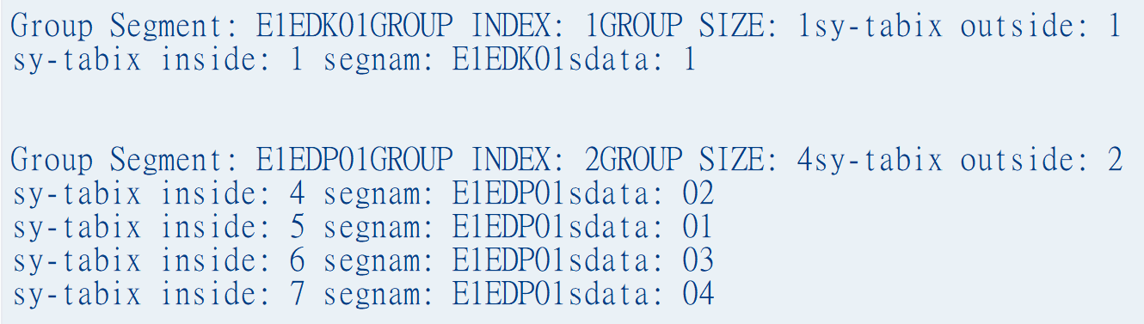
LOOP AT – GROUP - 3
Extended expressions
LOOP AT lt_idoc ASSIGNING FIELD-SYMBOL(<lwa_edidd>) " 1 work area assignment
WHERE segnam IN lt_seg " 2 'Where' used for focused data GROUP BY ( segnam = <lwa_edidd>-segnam " 3 Group by field size = GROUP SIZE " 4 This contains # of rows in <lfs_group> index = GROUP INDEX ) " 5 This is index# of group iteration ASCENDING AS TEXT " 6 Used to sorting Group data, here SEGNAM
" is used to improve performance but no
" access to the rows of the groups in the
“ group loop ” 7 WITHOUT MEMBERS ASSIGNING FIELD-SYMBOL(<lfs_group>) . “ 8 Group assignment WRITE: / |Group Segment:{ <lfs_group>-segnam }| & | GROUP INDEX:{ <lfs_group>-index }| &
|GROUP SIZE:{ <lfs_group>-size }| & | sy-tabix outside:{ sy-tabix }|.
“ LOOP at Group – Special syntax LOOP AT GROUP <lfs_group> ASSIGNING FIELD-SYMBOL(<lfs_group_member>). WRITE : / |sy-tabix inside:{ sy-tabix } segnam:{ <lfs_group_member>-segnam }| & |sdata: { <lfs_group_member>-sdata }|. ENDLOOP.
SKIP 2.
ENDLOOP.
ABAP 7.40~

Slide 75
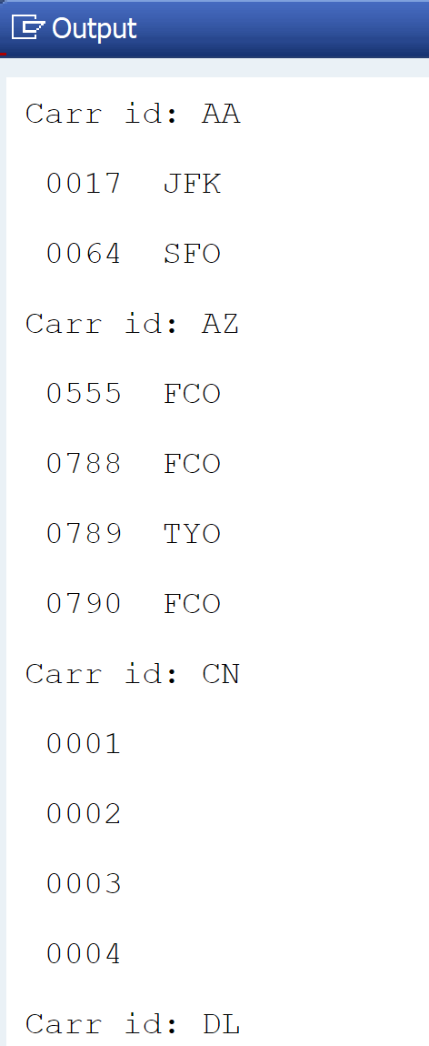
LOOP AT – GROUP - 4
Extended expressions
SELECT * FROM spfli INTO TABLE @DATA(spfli_tab). LOOP AT spfli_tab INTO DATA(wa) GROUP BY wa-carrid ASSIGNING FIELD-SYMBOL(<fly_group>). cl_demo_output=>write( |Carr id: { <fly_group> } | ).
LOOP AT GROUP <fly_group> ASSIGNING FIELD-SYMBOL(<fly_member>). cl_demo_output=>write( | { <fly_member>-connid }| & | { <fly_member>-airpfrom }| ). ENDLOOP. ENDLOOP. cl_demo_output=>display( ).
ABAP 7.40~

Slide 76

Agenda
1
Extended expressions
2
New ABAP Conversions
3
New ABAP SQL
4
Native SQL
5
ADBC

Slide 77
New ABAP provides new types of conversions which are not only time saver but also performance tuned. Some of the most important conversions are Alpha conversion, Date/Time conversion, Number conversion etc.
New ABAP Conversions
ALPHA Conversion -1
DATA: lv_matnr11 TYPE matnr value '101001', lv_matnr22 TYPE matnr value '0000000000000000000000000000000001012'. WRITE: /1 | Material no: { lv_matnr11 } |. WRITE: /1 | { lv_matnr11 ALPHA = IN } |. 0000000000000000000000000000000000101001 WRITE: /1 | { lv_matnr11 ALPHA = OUT } |. 101001 WRITE: /1 | Material no: { lv_matnr22 }|. WRITE: /1 | { lv_matnr22 ALPHA = IN }|. 0000000000000000000000000000000000001012 WRITE: /1 | { lv_matnr22 ALPHA = OUT }|. 1012
ABAP 7.40~

Slide 78
New ABAP Conversions
ALPHA Conversion -2
DATA: lv_matnr11 TYPE matnr VALUE '101001',
lv_matnr22 TYPE matnr VALUE '0000000000000000000000000000000001012'.
" Alpha IN for lv_matnr11
CALL FUNCTION 'CONVERSION_EXIT_ALPHA_INPUT'
EXPORTING
input = lv_matnr11
IMPORTING
output = lv_matnr11.
WRITE: / 'Material no (Alpha IN for lv_matnr11): ', lv_matnr11.
" Alpha OUT for lv_matnr11
CALL FUNCTION 'CONVERSION_EXIT_ALPHA_OUTPUT'
EXPORTING
input = lv_matnr11
IMPORTING
output = lv_matnr11.
WRITE: / 'Material no (Alpha OUT for lv_matnr11): ', lv_matnr11.
ECC
" Alpha IN for lv_matnr22
CALL FUNCTION 'CONVERSION_EXIT_ALPHA_INPUT'
EXPORTING
input = lv_matnr22
IMPORTING
output = lv_matnr22.
WRITE: / 'Material no (Alpha IN for lv_matnr22): ', lv_matnr22.
" Alpha OUT for lv_matnr22
CALL FUNCTION 'CONVERSION_EXIT_ALPHA_OUTPUT'
EXPORTING
input = lv_matnr22
IMPORTING
output = lv_matnr22.
WRITE: / 'Material no (Alpha OUT for lv_matnr22): ', lv_matnr22.

Slide 79
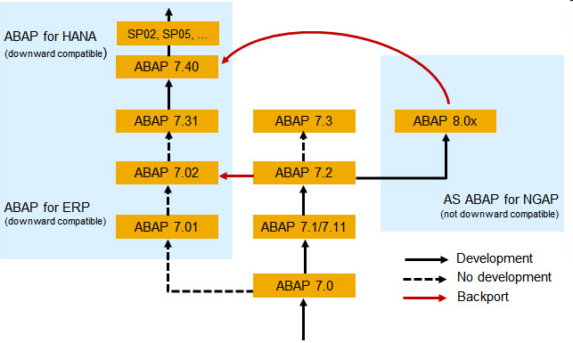

Slide 80

Agenda
1
Extended expressions
2
New ABAP Conversions
3
New ABAP SQL
4
Native SQL
5
ADBC

Slide 81

Classical Open SQL and Its Limitation
New Open SQL
Open SQL in ABAP < 7.4 SPS05 does not support everything possible with standard SQL DML or SAP HANA SQL
Standard SQL DML:
Fixed-value and computed columns
Sub-queries in the SELECT or FROM clauses
UNIONs
CASE expression
Additional Join types
HANA SQL:
Using HANA built-in functions, e.g., DAYS_BETWEEN( )
Accessing HANA Views
New Open SQL & Core Data Services in ABAP 7.4 SP05 support more

Slide 82

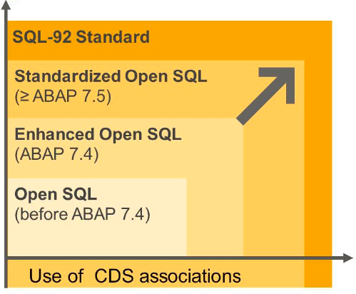
Classical Open SQL and Its Limitation
New Open SQL
Open SQL is the only DB abstraction layer that defines a common semantic for all
SAP supported databases
Limitations in ABAP < 7.4 SP05:
No expressions
Limited JOIN types
No UNION and UNION ALL
Additional restrictions
Minimize the limitations:
Support more standard SQL features in Open SQL – for SAP HANA and other database platforms

Slide 83
New Open SQL
New Open SQL syntax:
ABAP variables escaped with “@”
Comma-separated column list
Arithmetic expressions using +, -, *, /, DIV, MOD, ABS, FLOOR, CEIL
Common semantics
String concatenation
SQL CASE, COALESCE
Implication:
Strict mode: Nearly all former warnings transform into syntax errors.
SELECT carrid, connid, fldate, bookid, customid
FROM sbook
INTO TABLE @lt_bookings
WHERE customid = @lv_customer.
SELECT carrid, connid, fldate, bookid, customid, CASE smoker WHEN 'X' THEN FLOOR( loccuram * @lc_smoker_fee ) ELSE
CEIL( loccuram * @lc_nonsm_disc ) END AS adjusted_amount, CAST( loccuram AS FLTP ) / CAST( 2 AS FLTP ) AS half, loccurkey FROM sbook INTO TABLE @lt_bookings2 WHERE customid = @lv_customer.

Slide 84
New Open SQL
INTO clause at the end:
For consistency with UNION syntax
Additions such as UP TO ... ROWS after INTO
SELECT carrid, connid, fldate, bookid, customid
FROM sbook
WHERE customid = @lv_customer
INTO TABLE @lt_bookings UP TO 10 ROWS.
Keyword FIELDS:
Exchange order of field list and FROM clause
FROM clause first results in code-completion friendly syntax
SELECT FROM sbook
FIELDS carrid, connid, fldate, bookid, customid
WHERE customid = @lv_customer
INTO TABLE @lt_bookings UP TO 10 ROWS.

Slide 85
New Open SQL
Support for UNION and UNION ALL:
Only explicit field lists allowed – no *
INTO clause must be at the end
SELECT FROM sbook
FIELDS carrid, connid, fldate, bookid, customid,
FLOOR( loccuram * @lc_smoker_fee ) AS smoker_fee,
CAST( loccuram AS FLTP ) / CAST( 2 AS FLTP ) AS half,
loccurkey
WHERE customid = @lv_customer
AND smoker = 'X'
UNION ALL
SELECT FROM sbook
FIELDS carrid, connid, fldate, bookid, customid,
CEIL( loccuram * @lc_nonsm_disc ) AS nonsm_disc,
CAST( loccuram AS FLTP ) / CAST( 2 AS FLTP ) AS half,
loccurkey
WHERE customid = @lv_customer
AND smoker = ' '
INTO TABLE @lt_bookings2.

Slide 86
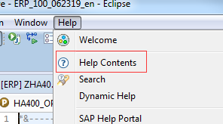
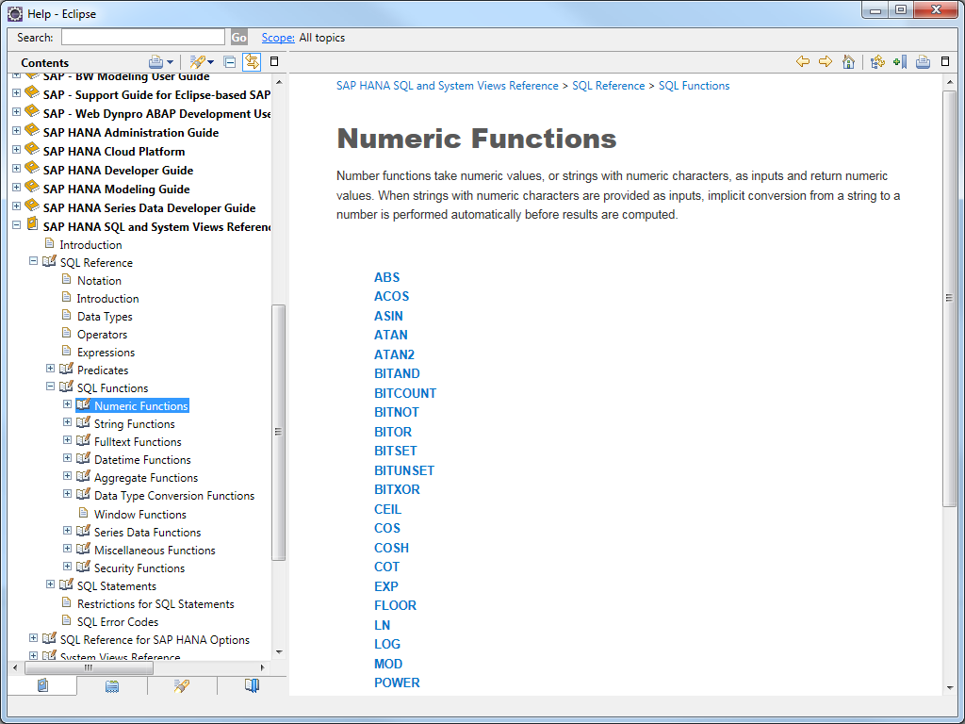
Hana SQL reference

Slide 87
Comma and Escaping variable - 1 Comma: With New SQL, fields to be selected are separated by comma operator ( , ). Old SQL statement is still valid however the written SQL should be either fully new SQL or old SQL… mixing both syntaxes give a syntax error! e.g. If a field list is separated by a comma, the host variables must be escaped with @ sign. Escaping Variable: Now any Variable, Work area or internal table which are local to logic, must be escaped with @ sign when using New SQL. This clearly distinguishes the table fields from external variables.
New ABAP SQL

Slide 88
Comma and Escaping variable - 2 SELECT vbeln, posnr FROM vbap INTO TABLE @DATA(lt_vbap). IF sy-subrc IS INITIAL. WRITE:/1 'Data exists'. ENDIF.
New ABAP SQL

Slide 89
Selecting a Constant - 1 Selecting a constant is possible now in a SELECT query. There may be different reasons for selecting a constant, however, in reality, it doesn't fetch anything from the database. e.g. This can be readily used for existence check.
New ABAP SQL

Slide 90
Selecting a Constant - 2 DATA: lv_matnr TYPE mara-matnr VALUE '1102'. SELECT SINGLE @abap_true FROM mara INTO @DATA(lv_exists) WHERE matnr = @lv_matnr. IF lv_exists IS NOT INITIAL. WRITE: |Material # { lv_matnr } exists |. ELSE. WRITE: |Material # { lv_matnr } NOT exists |. ENDIF.
New ABAP SQL

Slide 91
Arithmetic Calculation - 1
New ABAP SQL
Basic arithmetic calculation inside SQL query.
Some arithmetic operations which are now possible are:
.Addition,
.Subtraction,
.Multiplication,
.Division, and
.Calculating remainder value(MOD)

Slide 92
Arithmetic Calculation - 2
New ABAP SQL
ABS(argument)
(Gives absolute value of argument)
DIVISION(argument1, argument2, DEC)
(Result is division of argument1 "by argument2 and rounded to DEC
number of places)
DIV(argument1, argument2)
(Gives Integer part of Division operation)
FLOOR(argument)
(Provides just immediate smaller neighbor Integer)
CEIL(argument)
(Provides just immediate bigger neighbor Integer)
DATS_ADD_DAYS(date1, dayCount, if_error)
(Returns a date, dayCount days after date1)
DATS_DAYS_BETWEEN(date1, date2)
(Returns interval between 2 dates)

Slide 93
Arithmetic Calculation - 3
New ABAP SQL
CONCAT_WITH_SPACE(argument1, argument2, )
(concatenates arguments with number of spaces provided in 3rd argument)
CONCAT(argument1,….)
(concatenates arguments, trailing blanks are not taken into account)
LENGTH(argument)
(Gives length of argument but ignores trailing blanks)
LOWER(argument)
(Converts the string argument to lower case)

Slide 94
Arithmetic Calculation - 4 SELECT carrid, seatsmax, seatsocc, ( seatsmax - seatsocc ) as seatsfree FROM sflight INTO TABLE @DATA(lt_flight_data).
New ABAP SQL

Slide 95
Concatenation in SQL - 1
New ABAP SQL
Enhanced ABAP gives another new feature of concatenation which makes it possible to concatenate multiple selected fields which can be merged with hardcoded strings, spaces or delimiters.'
Concatenation in new Open SQL query is achieved with && operator. If any hardcoded string is to be also concatenated, it is enclosed inside single quotes. All variables, constants and hardcoded literals are kept inside small brackets "( … )". As the last syntax action, 'to be concatenated text' is given an alias with AS keyword. This will effectively create a field with given alias in the created internal table .

Slide 96
Concatenation in SQL - 2
New ABAP SQL
SELECT vbeln, ernam, ( vbeln && '|' && ernam ) AS key FROM vbap INTO TABLE @DATA(lt_vbap_data). LOOP AT lt_vbap_data ASSIGNING FIELD-SYMBOL(<ls_vbap_data>). WRITE: /1 <ls_vbap_data>-vbeln, <ls_vbap_data>-ernam, <ls_vbap_data>-key. ENDLOOP.

Slide 97
CASE Statement - 1 Case inside SELECT simplifies application logic and make code easy to understand. To name a few, some of the most important advantages of the CASE statement is as below: 1. No need to do a separate loop on internal table generated by SQL query just for CASE-based filtering data fetched from the database. 2. This reduces overall effort and number of lines of code to be written 3. It is possible to code push down a complex business logic to the database layer which practically makes execution faster on HANA database CASE keyword works with WHEN, THEN and ELSE keywords and entire CASE statement have to be given an alias with AS.
New ABAP SQL

Slide 98
CASE Statement - 2 SELECT matnr, mtart, CASE mtart WHEN 'FERT' THEN '成品' WHEN 'HALB' THEN '半成品' WHEN 'ROH' THEN '原料' ELSE ‘其他' END AS material_type FROM mara INTO TABLE @DATA(lt_mara_data). LOOP AT lt_mara_data ASSIGNING FIELD-SYMBOL(<ls_mara_data>). WRITE: /1 <ls_mara_data>-matnr, <ls_mara_data>-mtart, <ls_mara_data>-material_type. ENDLOOP.
New ABAP SQL

Slide 99
CTE – Common Table Expressions -1
New ABAP SQL
CTE – Common Table Expression is one of the revolutionary concepts in ABAP SQL where it is very simple to push down multiple chained SQL queries into one and hit Database once. With Introduction of CTE, developers should refrain from the practice of writing SQL followed by sy-subrc check and then another query inside sy-subrc condition based on the result of the first query.
CTEs can be deep and long. Result of one fetch is stored in + and this can be subsequently used further part of CTE as if it were a Transparent table
CTE is an extension of Open SQL and Subquery mechanism where multiple queries can be joined using WITH keyword along with + and last part of Query works for result consolidation. Some important point regarding CTE is as follows:

Slide 100
CTE – Common Table Expressions -2
New ABAP SQL
Each Query part name of CTE(name starts with +) should be unique
UNION/DISTINCT/ALL can be used
Each CTE expression is separated by a comma
AS keyword is followed by a subquery. SELECT from SUBQUERY can also be used in the context of CTE.
CTE syntax which starts by WITH keyword can be closed by an ENDWITH,
however, it will have the same effect as SELECT-ENDSELECT
CTE and buffering doesn't go together
Keyword CLIENT SPECIFIED can be used to override default client handling

Slide 101
CTE – Common Table Expressions -3
New ABAP SQL
" CTE Code WITH +customer AS ( "Part 1 – Fetching Customer data SELECT DISTINCT b~matnr, b~werks, b~charg, b~sobkz, b~kunnr,
b~kulab FROM kna1 AS a INNER JOIN msku AS b ON a~kunnr = b~kunnr WHERE a~ktokd = 'ZC01' AND b~werks = '1000' AND b~kulab GT 0 ),
+marc AS ( "Part 2 – Fetching Material Plant Data SELECT matnr, werks FROM marc WHERE matnr IN ( SELECT DISTINCT matnr FROM +customer ) AND werks IN ( SELECT DISTINCT werks FROM +customer ) ),

Slide 102
CTE – Common Table Expressions -4
New ABAP SQL
+mch1 AS ( "Part 3 – Fetching Batch Data SELECT matnr, charg, vfdat FROM mch1 WHERE matnr IN ( SELECT DISTINCT matnr FROM +customer ) AND charg IN ( SELECT DISTINCT charg FROM +customer ) ), +result AS ( " Part 5 – combining above data SELECT cu~matnr, cu~werks, cu~charg, cu~sobkz, cu~kunnr, cu~kulab, mc~vfdat FROM +customer AS cu LEFT OUTER JOIN +marc AS ma ON cu~matnr = ma~matnr AND cu~werks = ma~werks LEFT OUTER JOIN +mch1 AS mc ON cu~matnr = mc~matnr AND cu~charg = mc~charg )
"Part 6 – Preparing result SELECT * FROM +result ORDER BY matnr, werks, kunnr INTO TABLE @DATA(lt_res).
LOOP AT lt_res ASSIGNING FIELD-SYMBOL(<ls_res>). WRITE: /1 <ls_res>-matnr. ENDLOOP.

Slide 103
INSERT with SELECT - 1
New ABAP SQL
With new ABAP, it is now possible to INSERT in a database table by SELECTing and INSERTing together in one statement.
INSERT statement is followed by an immediate SELECT statement. SELECT statement can be any valid SELECT statement and can vary from a simple select to complex SELECT consists JOINs and UNIONs.
This strategy can reduce database overhead because it hits database once

Slide 104
INSERT with SELECT - 2
New ABAP SQL
INSERT zdemo_table FROM
( SELECT * FROM demo_expressions
).

Slide 105
Case Insensitive search with SELECT - 1 Case Insensitive search can be achieved by using a combination of either of two: 1. String function TO_LOWER( ) and SQL string function LOWER( ) with LIKE operator 2. String function TO_UPPER( ) and SQL string function UPPER( ) with LIKE operator
New ABAP SQL

Slide 106
Case Insensitive search with SELECT - 2
New ABAP SQL
"Lower case DATA(search_term) = 'sensor '. search_term = |%{ to_lower( search_term ) }%|.
SELECT DISTINCT matnr ,spras, maktx FROM makt WHERE lower( maktx ) LIKE @search_term INTO TABLE @DATA(lt_search_result). IF sy-subrc IS INITIAL. cl_demo_output=>display( lt_search_result ). ELSE. WRITE : 'Search failed!'. ENDIF.

Slide 107

Agenda
1
Extended expressions
2
New ABAP Conversions
3
New ABAP SQL
4
Native SQL
5
ADBC

Slide 108
SAP Open SQL and Native SQL

Slide 109
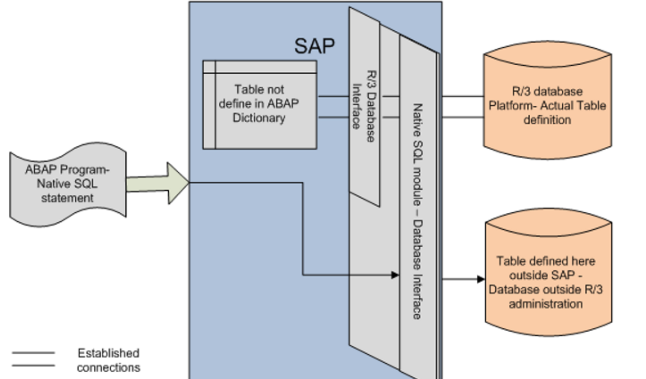
Native SQL

Slide 110
Features of SAP Open SQL & SAP Native SQL
Feature | SAP Native SQL | SAP Open SQL
SQL Type | Database-specific | Database-independent SQL defined by SAP
Access Method | Bypasses ABAP Database Interface Layer | Uses ABAP Database Interface Layer
Compatibility | Not adaptable to all SAP systems | Adaptable to all SAP systems
Access Scope | Can access tables, views, stored procedures, third-party databases | Can only access tables and views created in ABAP Dictionary
Cache Use | Does not use cache | Uses cache
Typical Use Cases | Used for DML, DDL, DCL, modifying database objects directly | Used for DML operations (SELECT, INSERT, UPDATE, DELETE)
Security Risk | Can modify/delete tables, higher security risk | Lower security risk
Database Independence | Depends on the underlying database | Independent of underlying database
Operation Scope | Can operate on objects not managed by ABAP Dictionary | Limited to DML on ABAP Dictionary objects

Slide 111
Native SQL

Slide 112
Notes and precautions
After SAP is upgraded to S4, only SAP HANA database is supported. In theory, HANA database is backward compatible, so ABAP programs based on Hana's Native SQL are also reusable.
Native SQL will not filter the current client number by default like Open SQL, and all statements need to be specified by yourself.

Slide 113
Native SQL (Exec SQL)
Native SQL
EXEC SQL
[ PERFORMING <form_routine> ].
<native_sql_statements>
ENDEXEC.

Slide 114
Get a single record
Native SQL
DATA: lv_count TYPE i.
EXEC SQL.
select count(1) into :lv_count
from saphanadb.scarr
where mandt = :sy-mandt ;
ENDEXEC.
WRITE:/ lv_count.

Slide 115
Get multiple rows
Native SQL
DATA: lv_carrid TYPE scarr-carrid,
lv_carrname TYPE scarr-carrname.
EXEC SQL PERFORMING Write_data.
select carrid, carrname into :lv_carrid,:lv_carrname
from saphanadb.scarr
where mandt = :sy-mandt ;
ENDEXEC.
FORM Write_data.
WRITE:/ lv_carrid,'',lv_carrname.
ENDFORM.

Slide 116
Cursor Application
Native SQL
DATA: BEGIN OF gs_scarr,
carrid TYPE scarr-carrid,
carrname TYPE scarr-carrname,
END OF gs_scarr.
EXEC SQL.
OPEN cursor FOR
select carrid, carrname
from saphanadb.scarr
where mandt = :sy-mandt
ENDEXEC.
DO.
CLEAR gs_scarr.
EXEC SQL.
FETCH NEXT cursor INTO :gs_scarr
ENDEXEC.
IF sy-subrc <> 0.
EXIT.
ELSE.
WRITE:/ gs_scarr-carrid,‘’,
gs_scarr-carrname.
ENDIF.
ENDDO.
EXEC SQL.
CLOSE cursor
ENDEXEC.

Slide 117
Exception Handling
Native SQL
DATA lv_store_dbs TYPE dbcon-con_name.
DATA: lv_exc_ref TYPE REF TO cx_sy_native_sql_error,
lv_error_text TYPE string.
TRY.
EXEC SQL.
CONNECT TO :lv_store_dbs
ENDEXEC.
IF sy-subrc <> 0.
RAISE EXCEPTION TYPE cx_sy_native_sql_error.
ENDIF.
CATCH cx_sy_native_sql_error INTO lv_exc_ref.
CLEAR: lv_error_text.
lv_error_text = lv_exc_ref->get_text( ).
MESSAGE lv_error_text TYPE 'I'.
ENDTRY.

Slide 118
Executing DDL Statements
Native SQL
DATA: lv_count TYPE i.
DATA: lv_exc_ref TYPE REF TO cx_sy_native_sql_error,
lv_error_text TYPE string.
TRY.
EXEC SQL.
drop table zemployee
ENDEXEC.
IF sy-subrc <> 0.
RAISE EXCEPTION TYPE cx_sy_native_sql_error.
ENDIF.
EXEC SQL.
create table zemployee
(
no int,
name nvarchar(10),
sex nvarchar(1),
age int,
primary key (ZNo)
);
ENDEXEC.
IF sy-subrc <> 0.
RAISE EXCEPTION TYPE cx_sy_native_sql_error.
ENDIF.

Slide 119

Agenda
1
Extended expressions
2
New ABAP Conversions
3
New ABAP SQL
4
Native SQL
5
ADBC

Slide 120
ADBC
ABAP Database Connectivity

Slide 121
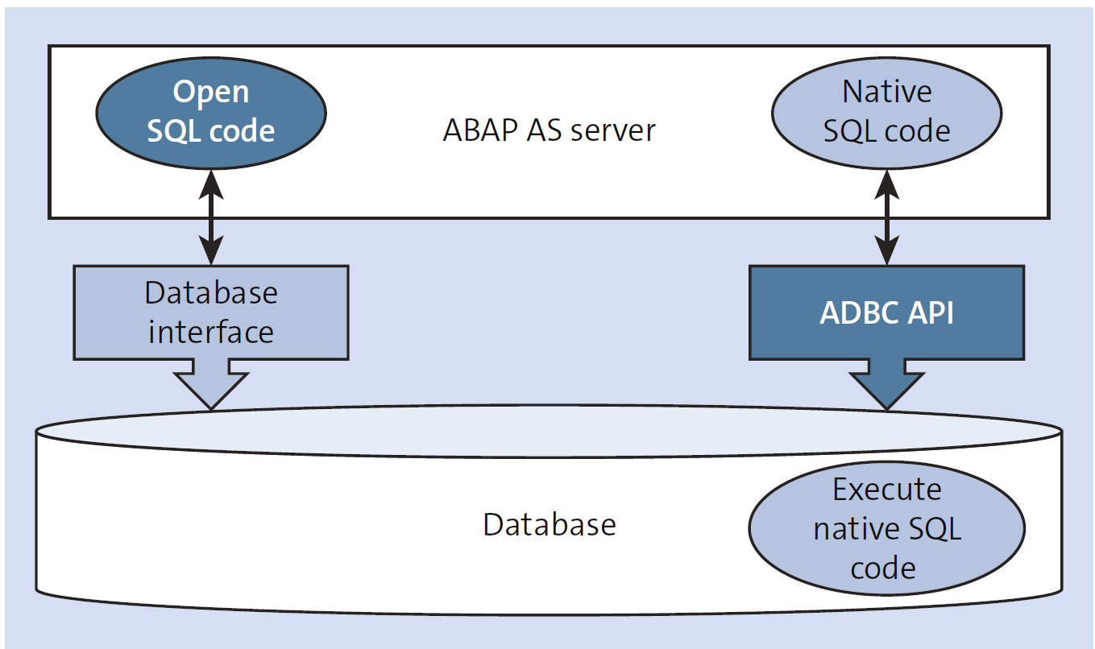
ABAP Database Connectivity

Slide 122
Native SQL vs ADBC in ABAP
Native SQL Overview
Direct database-specific SQL execution in ABAP.
Bypasses SAP Open SQL layer.
Flexible but dependent on the database system (e.g., HANA, Oracle).
Allows use of database-specific features not supported by Open SQL.
Use Cases:
When leveraging specific database features for performance.
Executing complex SQL queries that Open SQL cannot handle.
ADBC Overview
ABAP Database Connectivity introduced in ABAP 7.02.
Enables dynamic SQL execution and database interaction via ABAP classes.
More flexible than Open SQL, with dynamic SQL query support.
Provides cross-database compatibility and SQL execution without database-specific syntax.
Use Cases:
When building dynamic SQL queries based on runtime conditions.
Handling large result sets or complex queries in a database-independent manner.
Database-dependent.
Direct access to advanced features of specific databases.
Best for highly specialized queries and performance optimization.
Database-agnostic.
More flexible for dynamic SQL execution.
Ideal for cross-database compatibility and dynamic query scenarios.

Slide 123
Class Methods ADBC
The essence of ADBC ​​(ABAP Database Connectivity) is Native SQL, which is just encapsulated by classes. It is more in line with the object-oriented development concept and is relatively more friendly to development.
SAP provides you with a Native SQL interface API, which is mainly composed of 4 classes:
CL_SQL_STATEMENT - Execution of SQL Statements
CL_SQL_PREPARED_STATEMENT - Prepared SQL Statements
CL_SQL_CONNECTION - Administration of Database Connections
CX_SQL_EXCEPTION - Exception Class

Slide 124
Querying the Database
Interaction with any database requires four basic steps, which also apply when using ABAP database connectivity in SAP NetWeaver AS ABAP to connect to SAP HANA:
Connecting to the database
Preparing the SQL query to retrieve the result set
Executing the query
Getting the result set

Slide 125
Connect to the Database
Querying the Database
The first step is to prepare the connection to the database by class CL_SQL_CONNECTION / METHOD GET_CONNECTION,
as shown in the following:
DATA: lo_sql_conn TYPE REF TO cl_sql_connection,
TRY .
lo_sql_conn =cl_sql_connection=>get_connection( ).
CATCH cx_sql_exception.
ENDTRY.

Slide 126
Preparing the Query
Querying the Database
*Convert selection option to a where clause string
DATA(lo_seltab) = cl_lib_seltab=>new( it_sel = s_carrid[] ).
DATA(lv_where_clause_sel) = lo_seltab->sql_where_condition( iv_field = 'CARRID' ).
lv_statement = | SELECT |
&& |carrid,| && |connid,| && |fldate,| && |price,| && |currency|
&& |FROM sflight|
&& |WHERE mandt = '{ sy-mandt }'|
&& |AND '{ lv_where_clause_sel }'|.

Slide 127
Executing the Query
Querying the Database
TRY .
*Prepare Connection
lo_sql_conn =cl_sql_connection=>get_connection( ).
*Prepare the SQLStatement
lo_sql_stmt =lo_sql_conn->create_statement( ).
lo_sql_result =lo_sql_stmt->execute_query( lv_statement).
CATCH cx_sql_exception .
ENDTRY.

Slide 128
Retrieving Results
Querying the Database
TRY .
*Prepare Connection
lo_sql_conn =cl_sql_connection=>get_connection( ).
*Prepare the SQLStatement
lo_sql_stmt = lo_sql_conn->create_statement( ).
lo_sql_result = lo_sql_stmt->execute_query( lv_statement ).
*Pass resultset to the ref of the internal table to be displayed
lo_sql_result->set_param_table( lr_data ).
CATCH cx_sql_exception .
ENDTRY.

